Slide 1

CYCLISTIC BIKES ANALYSIS
By Jaime Ye

Slide 2
What are we talking about
The Data
Conclusions
ÍNDICE
Recomendations

Slide 3
WHAT ARE WE
TALKING
ABOUT
Cyclistic

Slide 4
OBJECTIVES
Determine how annual members and casual riders use Cyclistic Bikes differently, and How to use digital media to influence casual riders to become members
Cyclistic

Slide 5
CASUAL VS MEMBERS TENDENCIES OF BIKE RIDING
Cyclistic

Slide 6
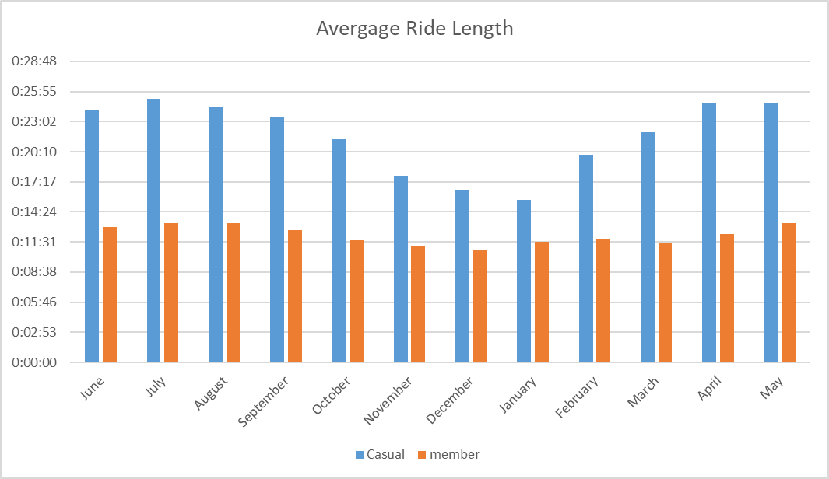
RIDE
LENGTHS
Casual riders have an higher average ride length than members
Cyclistic

Slide 7
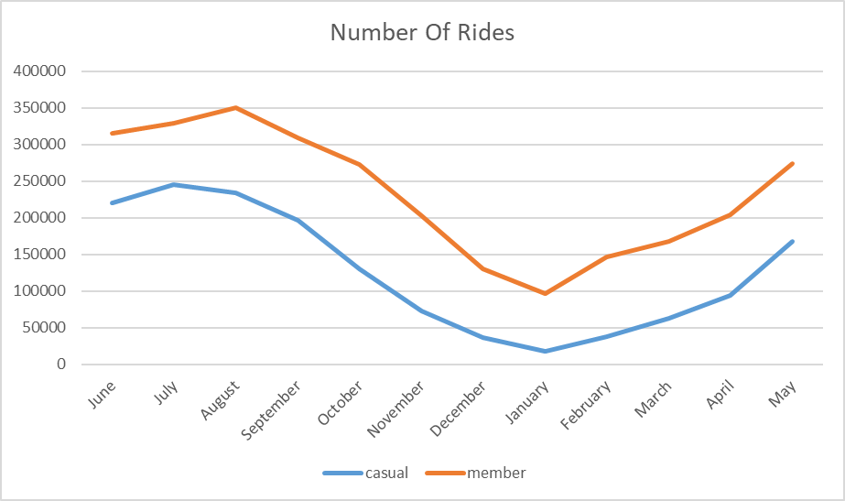
NUMBER
OF RIDES
Members make more rides than casual users.
The months of august- september has the most users in the year.
Cyclistic

Slide 8
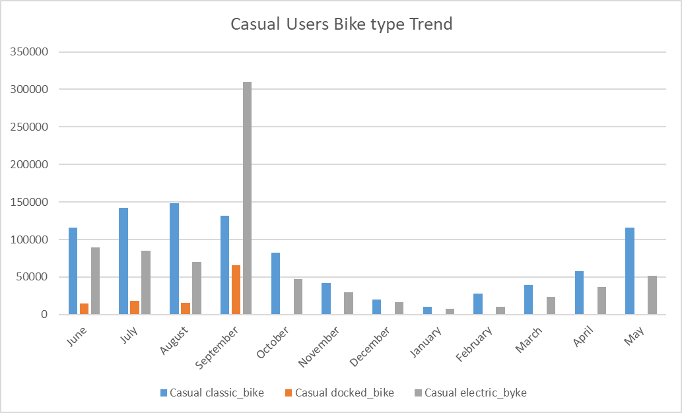
TYPES OF
BIKES USE
Casual users tend to use more classic bikes than others models.
September has a surge of users of electric bikes
Cyclistic

Slide 9
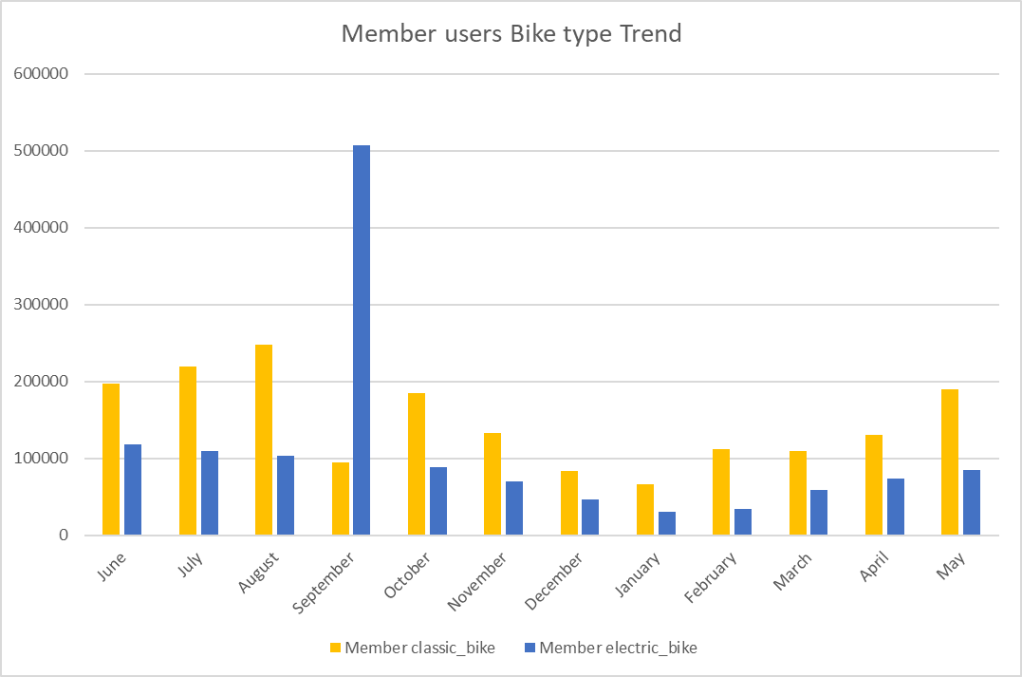
TYPES OF
BIKES USE
Member users tend to use more classic bikes than others models.
September has a surge of users of electric bikes
Cyclistic

Slide 10
CONCLUSION
Casual Rider
have a higher average ride
length
( 20+ minutes)
than members
(11 minutes)
Casual Users and Member Users have a tendency to like more casual model bikes
Members user tend to on average 150% more rides during anually then casual users
Cyclistic

Slide 11
RECOMENDATIONS
Inform campaign
Advertisement
Introduce new designs
casual user may know about the bike rental, but may not know about the benefits of becoming a members, a lot of casuals are frequent users, making them aware of the benefits may attract them to become members
During the months of July-September, make a campaign during summer break, to make new members by making discount to families than bring their children and become members, this will help get new users
Introducing colorfull and themed design bikes, will help attract the younger audience, making it more attractive to them, can bring them with their parents.

